Slide 1
MALIGNANT COMMENTS CLASSIFICATION
Aaron Dsouza

Slide 2
Agenda / Topics
Problem Definition
Data Analysis
EDA (Exploratory Data Analysis)
Pre-processing Pipeline
Building Machine Learning Models
Concluding Remarks

Slide 3
Problem Definition
Nowadays users leave numerous comments on different social networks, news portals, and forums. Some of the comments are toxic or abusive.
Due to numbers of comments, it is unfeasible to manually moderate them, so most of the systems use some kind of automatic discovery of toxicity using machine learning models.
Toxic comments are defined as comments that are rude, disrespectful, or that tend to force users to leave the discussion.
If these toxic comment can be automatically identified, we could have safer discussions on various social networks, news portals, or online forums.
Manual moderation of comments is costly, in effective, and sometimes infeasible. Automatic or semi-automatic detection of toxic comment is done by using different machine learning methods.

Slide 4
Data Analysis
The proliferation of social media enables people to express their opinions widely online. However, at the same time, this has resulted in the emergence of conflict and hate, making online environments uninviting for users.
Many celebrities and influences are facing backlashes from people and have to come across hateful and offensive comments. This can take a toll on anyone and affect them mentally leading to depression, mental illness, self-hatred and suicidal thoughts.
Our goal is to build a prototype of online hate and abuse comment classifier which can used to classify hate and offensive comments so that it can be controlled and restricted from spreading hatred and cyberbullying.

Slide 5
Data Analysis
Although researchers have found that hate is a problem across multiple platforms, there is a lack of models for online hate detection.
Online hate, described as abusive language, aggression, cyberbullying, hatefulness and many others has been identified as a major threat on online social media platforms. Social media platforms are the most prominent grounds for such toxic behavior.
Lately there has been many cases in which the growing menace of hate and negativity has been witnessed in the online platforms especially social media as such, many governments around the world has seen the rise of causes related to cyber bullying that has led to spread of hatred and violence.

Slide 6
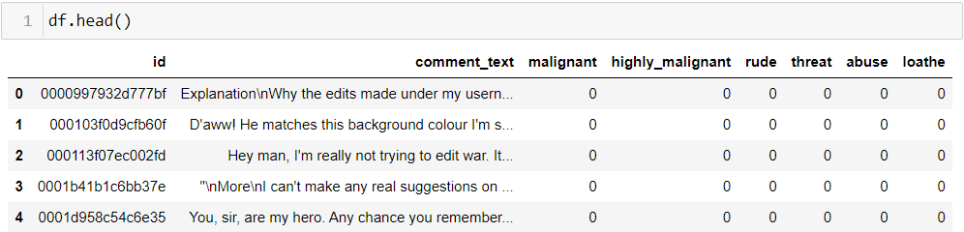
Data Analysis
Data-frame Sample

Slide 7
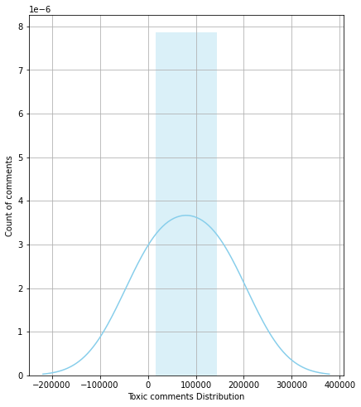
EDA (Exploratory Data Analysis)
The following plot shows the Toxic Comment Distribution

Slide 8
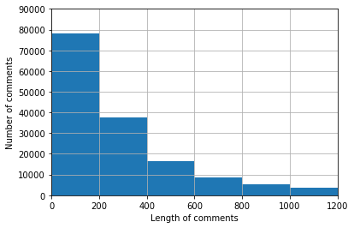
EDA (Exploratory Data Analysis)
Mean length of comment before cleaning data: 394.139

Slide 9
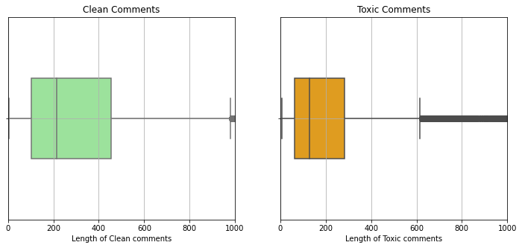
EDA (Exploratory Data Analysis)
Clean comments have higher word length then toxic comments.

Slide 10
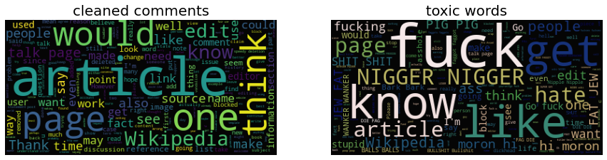
EDA (Exploratory Data Analysis)
Word clouds for cleaned and toxic words

Slide 11
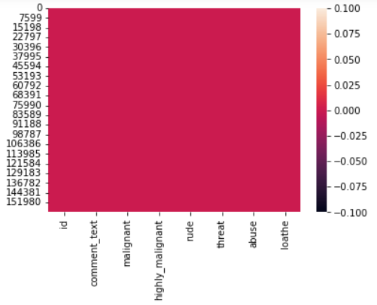
Pre-processing Pipeline
Checking for null values in the dataset

Slide 12
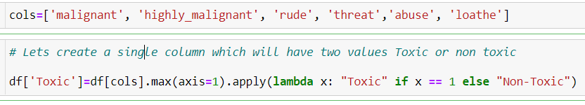
Pre-processing Pipeline
Creating a single column which will have two values Toxic or Non-Toxic

Slide 13
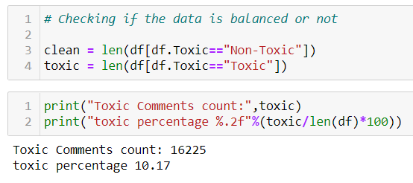
Pre-processing Pipeline
The Dataset is highly imbalanced.

Slide 14
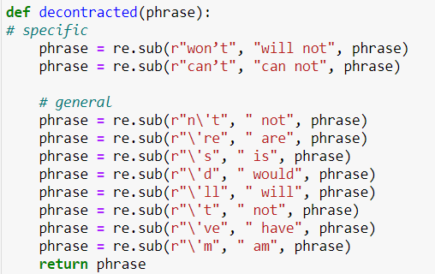
Pre-processing Pipeline
Text cleaning functions that replace short forms to full forms

Slide 15
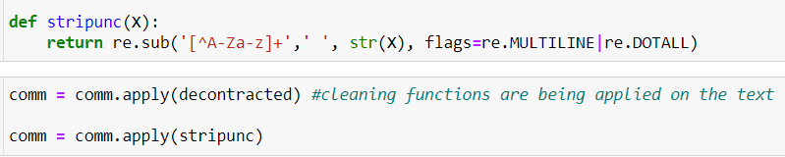
Pre-processing Pipeline
To remove the <.?/; and any numerical values from the text and applying the function.

Slide 16
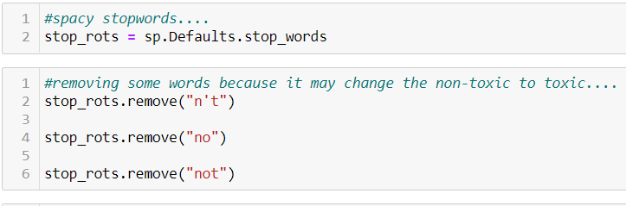
Pre-processing Pipeline
Removing Stop-words from the user comments.

Slide 17
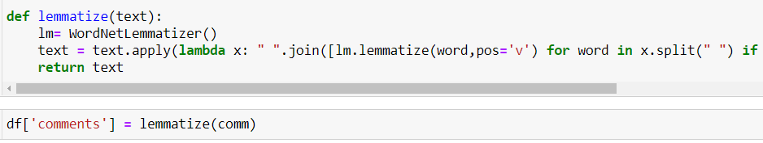
Pre-processing Pipeline
Applying Lemmatizer on user comments.

Slide 18
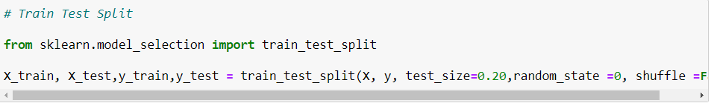
Pre-processing Pipeline
Train Test Splitting of data.

Slide 19
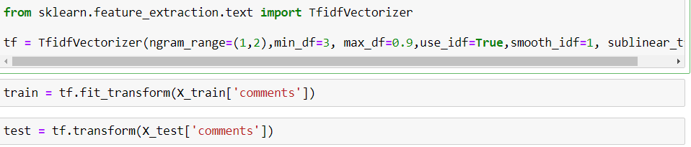
Pre-processing Pipeline
Applying TF-IDF vectorizer. TF-IDF vectorizer has been used as it is far better than bag of words approach.

Slide 20
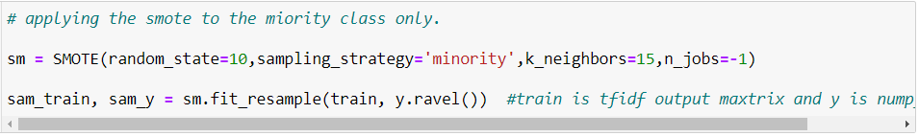
Pre-processing Pipeline
Applying SMOTE for the synthetic data points generation because of the class imbalance problem.

Slide 21
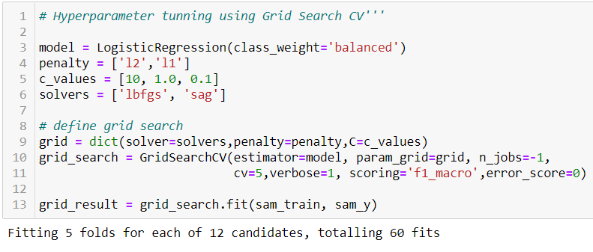
Building Machine Learning Models
Logistic Regression
Hyper-parametric Tuning

Slide 22
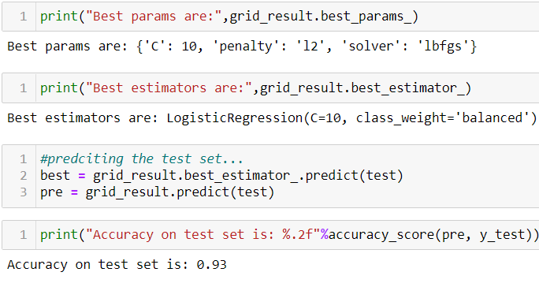
Building Machine Learning Models
Best Parameters, estimators and best score for Logistic regression.

Slide 23
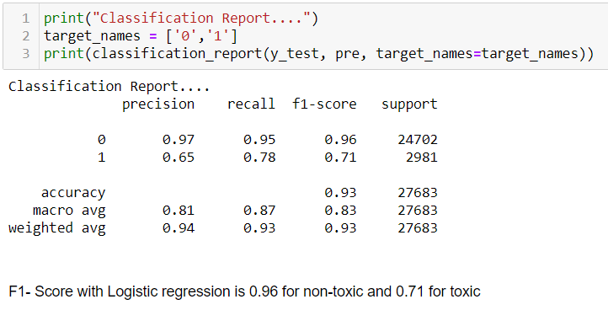
Building Machine Learning Models
Classification Report for Logistic Regression

Slide 24
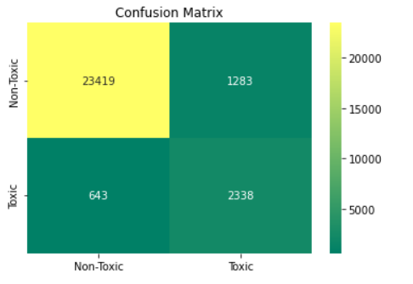
Building Machine Learning Models
Confusion matrix for Logistic Regression:

Slide 25
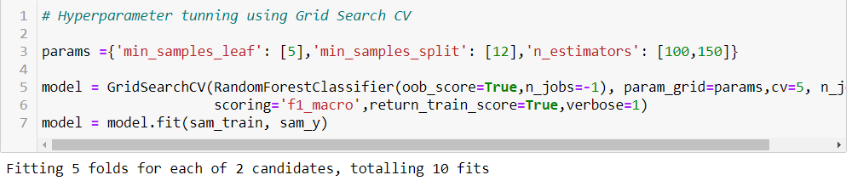
Building Machine Learning Models
Random Forest Classification Hyper-parametric Tuning:

Slide 26
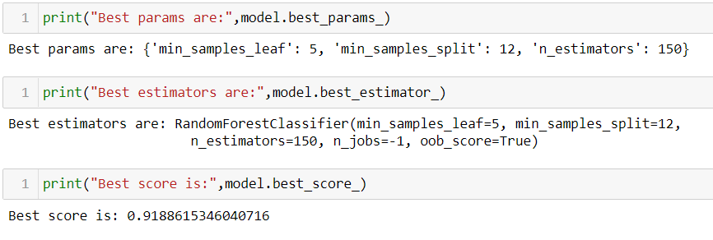
Building Machine Learning Models
Best Parameters, estimators and best score for Random forest classification.

Slide 27
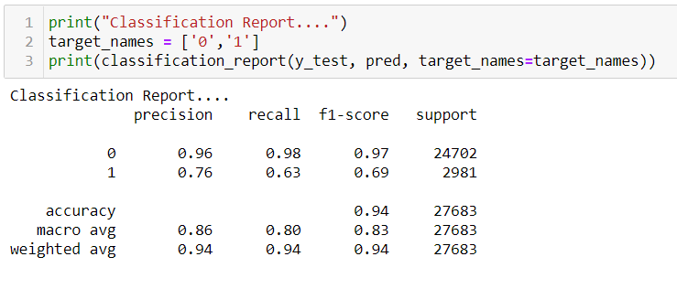
Building Machine Learning Models
Classification Report for Random forest classification

Slide 28
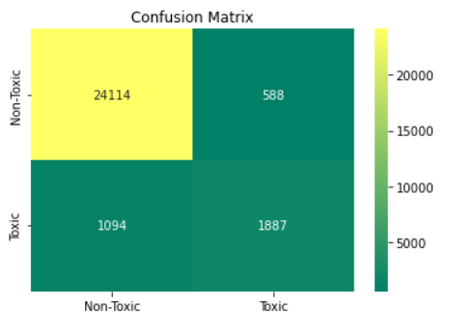
Building Machine Learning Models
Confusion matrix for Random Forest Classification

Slide 29
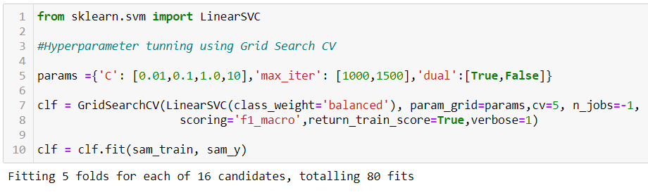
Building Machine Learning Models
Linear SVC Hyper-parametric Tuning

Slide 30
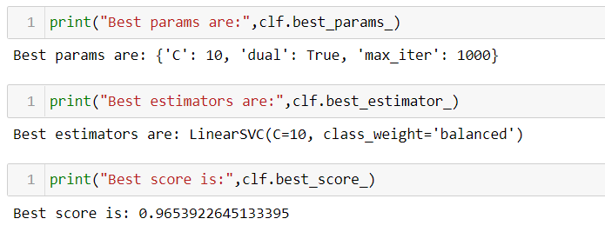
Building Machine Learning Models
Best Parameters, estimators and best score for Linear SVC

Slide 31
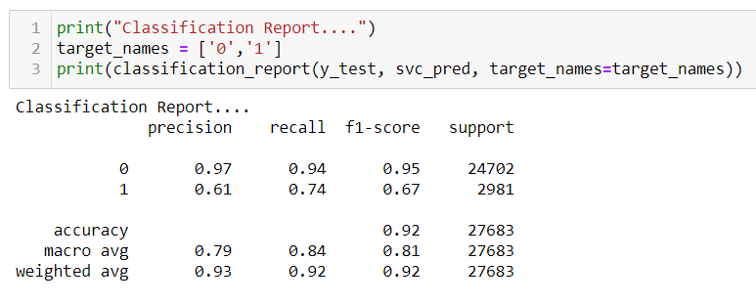
Building Machine Learning Models
Classification Report for Linear SVC

Slide 32
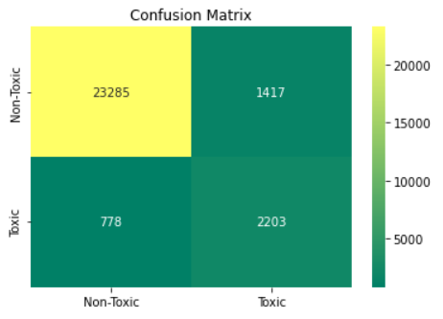
Building Machine Learning Models
Confusion Matrix for Linear SVC

Slide 33
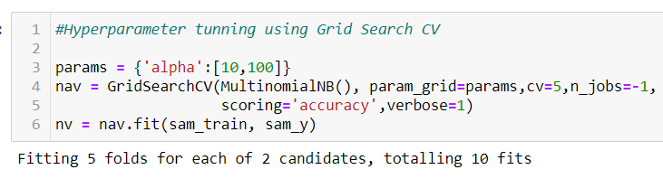
Building Machine Learning Models
Naive Bayes Hyper-parametric Tuning

Slide 34
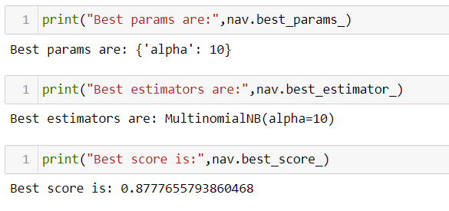
Building Machine Learning Models
Best Parameters, estimators and best score for Naive Bayes

Slide 35
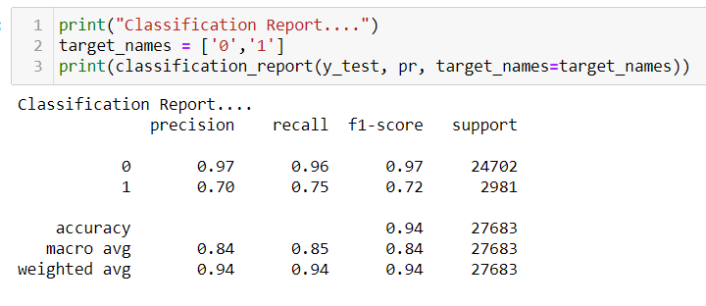
Building Machine Learning Models
Classification Report for Naive Bayes

Slide 36
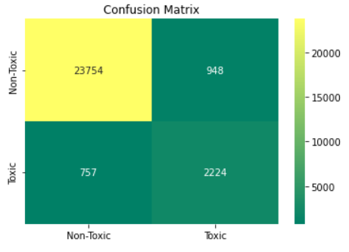
Building Machine Learning Models
Confusion Matrix for Naive Bayes(Multinomial)

Slide 37
Concluding Remarks
This project has discussed four approaches to discuss four machine learning algorithms (classification) and compared various metrics like Accuracy, F1 score, Recall and Precision.
Four classification algorithms were used Logistic Regression, Naive Bayes (Multinomial), Linear SVC and Random Forest classifier out of this four algorithms Naive Bayes (Multinomial) gave the best results.

